Slide 1
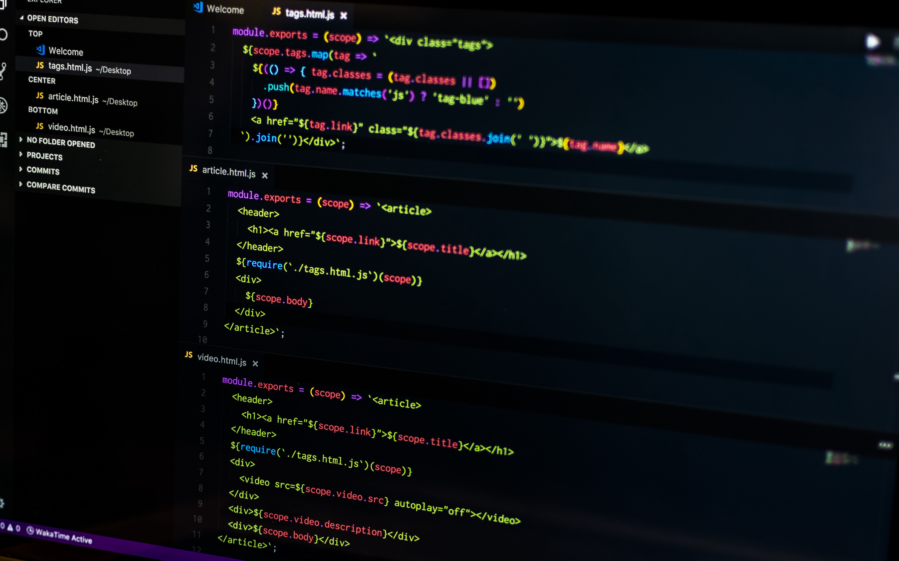

wordbook
DEVELOPED BY;
Georgi Georgiev ,Angel Zhelqzkov , Martin Bakalov, Mihail Atanasov

Slide 2
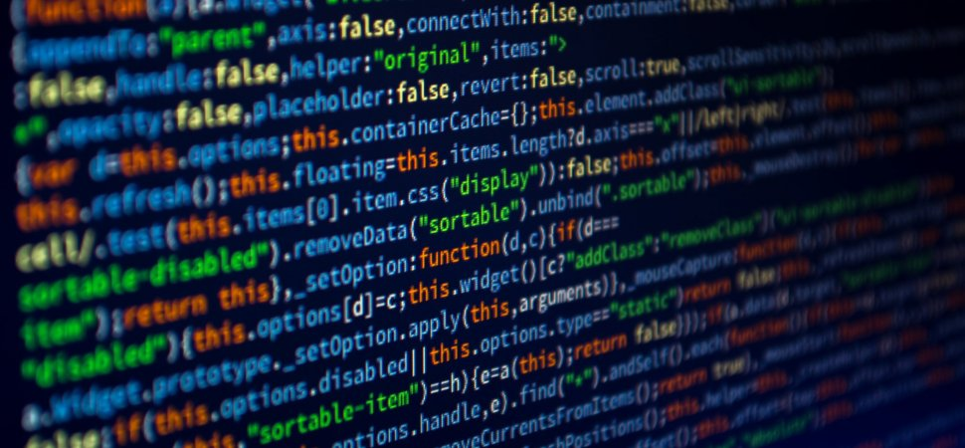
What did we use?
C++
Google
GitHub

Slide 3
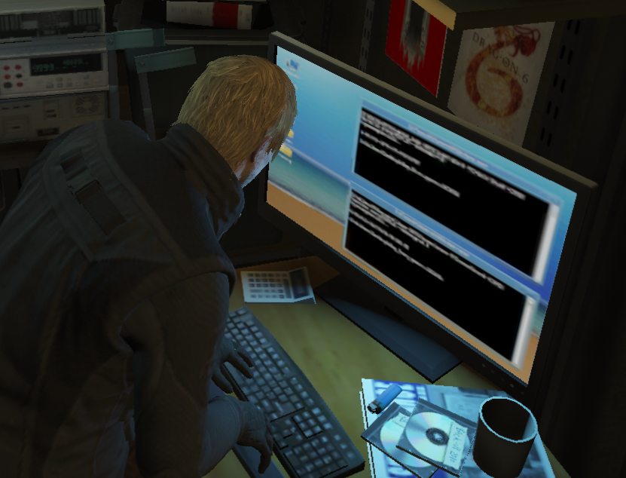
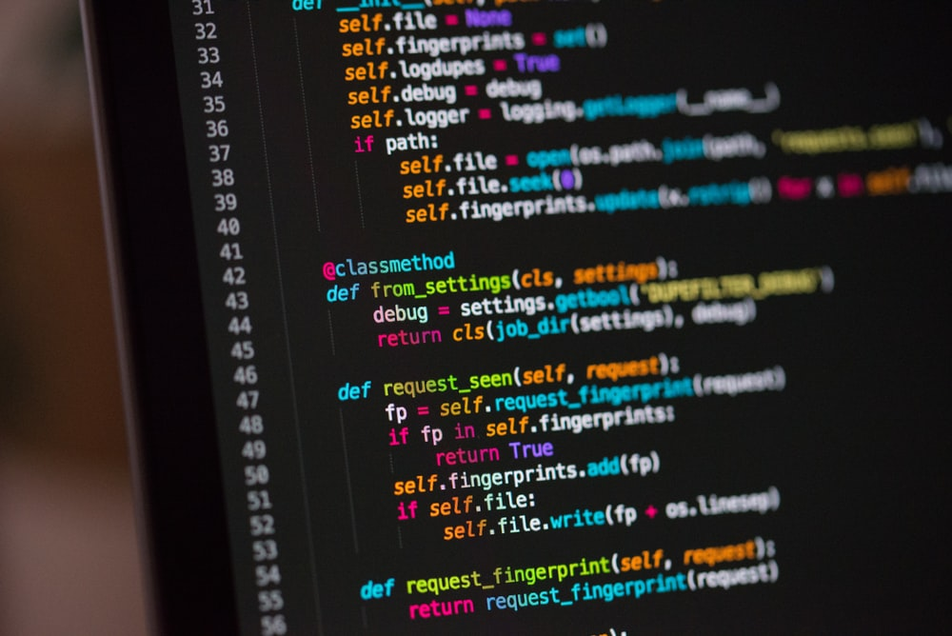
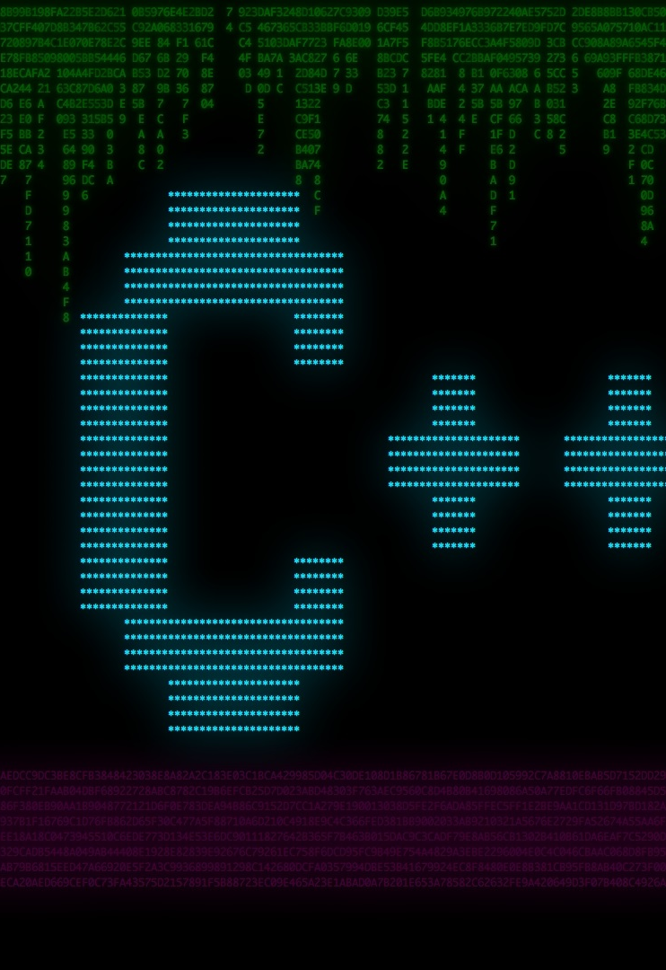
How we started?
Adding Words
Adding Descriptions
Adding Checking system

Slide 4

How does it work?
Our program is meant to help students and people with learning foreign languages by saving words, that they insert.

Slide 5
Our program in the future
Saving the words
more functionality
much more comfortable to use

Slide 6

Thank you!
FOR YOUR ATTENTION !

